Slide 1
House Keeper Scheduling System

Slide 2
Team 4
Name | Employee Id
Anupma Singh | 2563223
Amara Jyothi | 2563249
Sridhar A | 2563001
Kunal Chakraborty | 2563810
Debarupa Paul | 2562896
Syed Ariz Haider | 2563486
Bethamsetty Vamsikrishna Saisrinivas | 2563699
Prathiba K | 2563126
Mounika Janamala | 2564068
Perugu Soujanya | 2564567

Slide 3
House Keeper Scheduling System
The HOUSEKEEPER SCHEDULING SYSTEM is designed to ensure timely room cleaning for hostel students.
Admin selects housekeepers, assigns specific requests from students, and can register new housekeepers based on floor no.
The system manages housekeeper details, including name, hostel, floor, rooms_cleaned, and feedback.
It also maintains user feedback and request status, enhancing efficiency and communication within the hostel environment.

Slide 4
Tools used:
Server-side: Spring Boot, Spring Cloud, Spring Data JPA
Database: MySQL
Server: Embedded Tomcat
DevOps: Docker, Git Hub
Spring Cloud: Spring Cloud Config, Spring Cloud Netflix Eureka, Feign, Resilience4j, Retry, Sleuth and Zipkin.

Slide 5
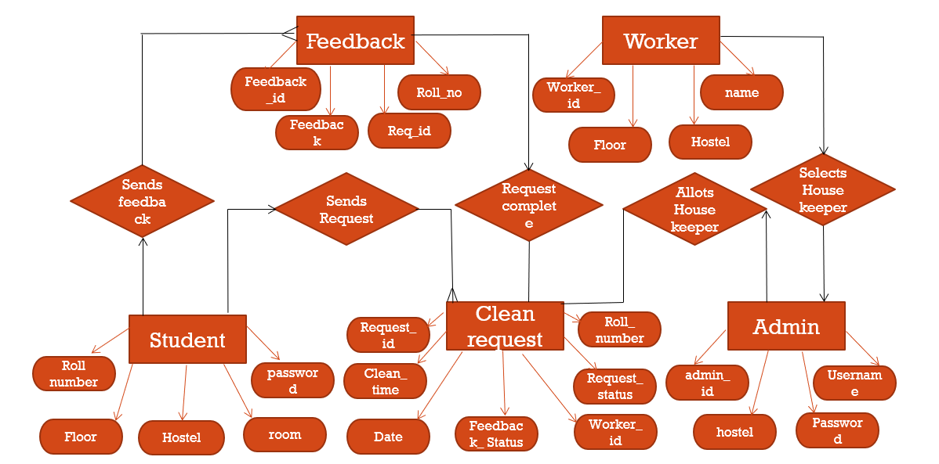
ER Diagram:

Slide 6
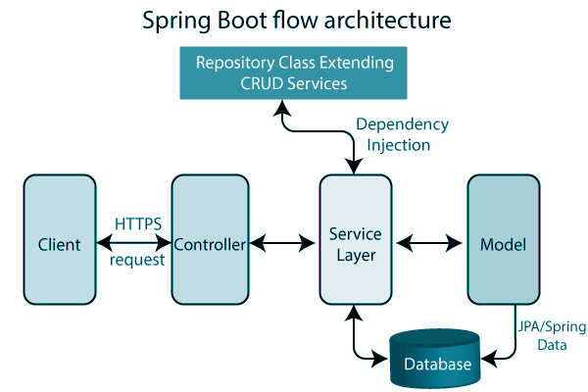
Spring boot Architecture:

Slide 7
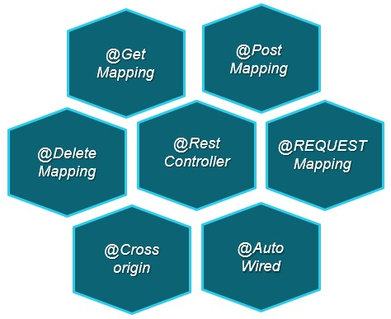
Controller layer:

Slide 8
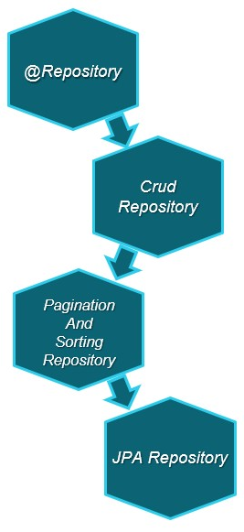
Service Layer:
A service layer is a layer in an application that facilitates communication between the controller and the persistence layer.

Slide 9
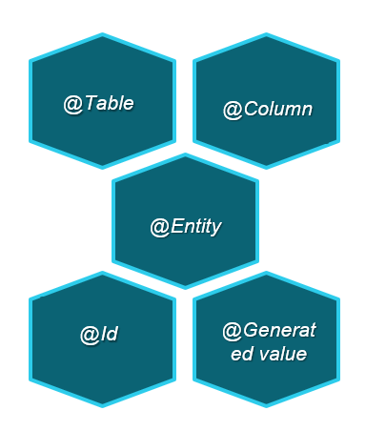
Model Layer:
The persistence layer contains all the storage logic and translates business objects from and to database rows.

Slide 10
Spring cloud config:
Spring Cloud Config provides server and client-side support for externalized configuration in a distributed system. With the Config Server you have a central place to manage external properties for applications across all environments.
The concepts on both client and server map identically to the Spring Environment and Property Source abstractions, so they fit very well with Spring applications, but can be used with any application running in any language.
As an application moves through the deployment pipeline from dev to test and into production you can manage the configuration between those environments and be certain that applications have everything they need to run when they migrate.

Slide 11
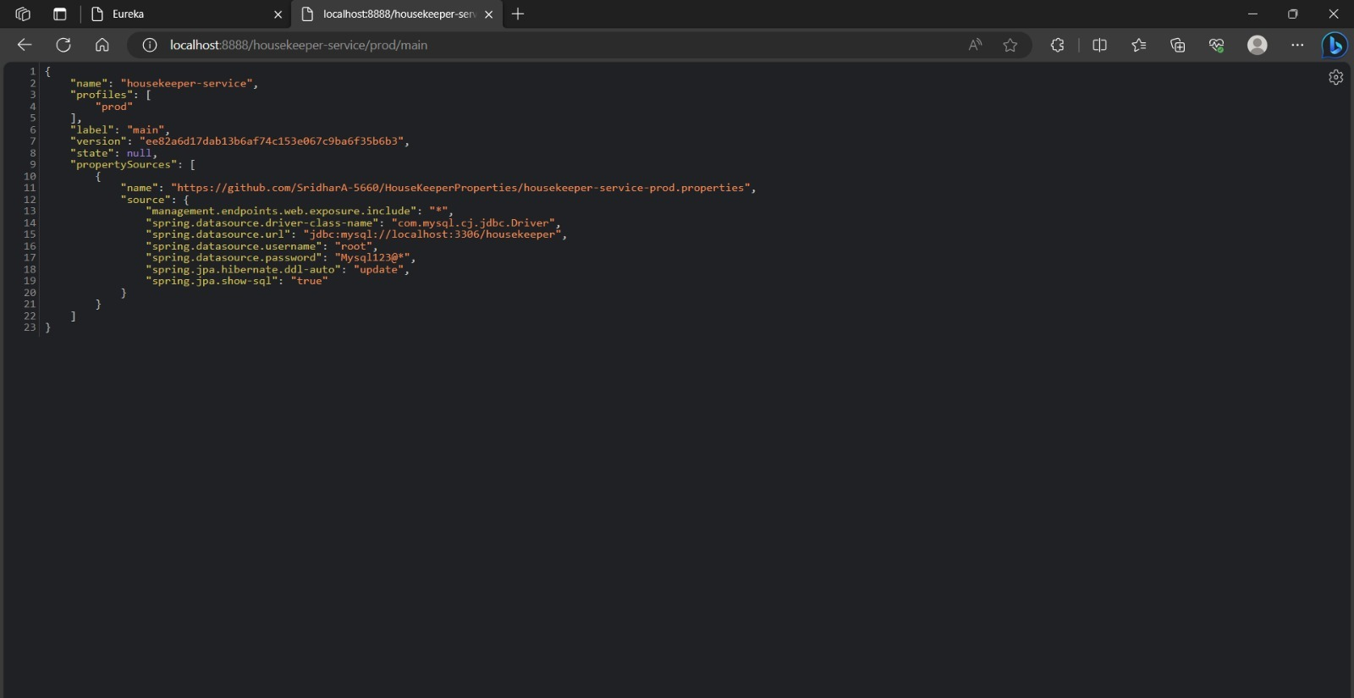

Slide 12
Eureka:
Eureka is a REST (Representational State Transfer) based service that is primarily used in the AWS cloud for locating services for the purpose of load balancing and failover of middle-tier servers.

Slide 13
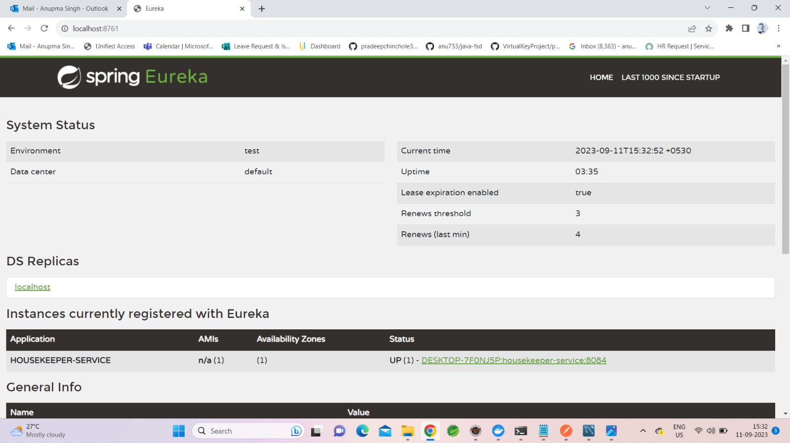

Slide 14
Feign Client
Declarative REST Client
Integrates with Resilience4J= Circuit Breaker
Eureka = Service Discovery
Feign Clients
Spring Cloud Starter
spring-cloud-starter-openfeign www.thoughts-on-java.org
Feign Clients
@EnableFeignClient on configuration class
@FeignClient annotation on interface
Resilience4J fallback
feign.circuitbreaker.enabled=true
Class implements fallback methods

Slide 15
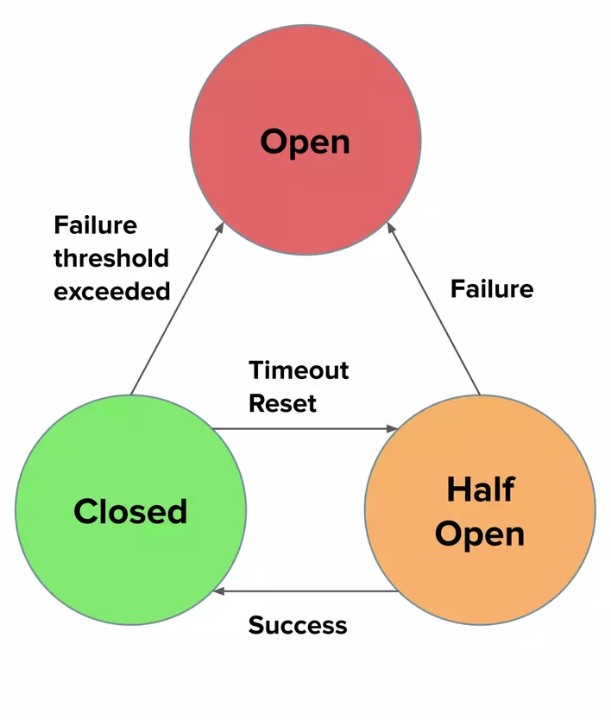
Circuit breaker:
Protects from cascading failures
Fallback
Pluggable
Resilience4j
Failure threshold exceeded
Spring Retry
Spring Cloud Alibaba (Sentinel)
Pluggable Algorithm
Reactive support

Slide 16
Retry
A "retry" function is typically used in programming to handle situations where an operation might fail temporarily, such as when making network requests or interacting with external services.
It allows you to attempt the operation multiple times until it succeeds or reaches a maximum number of retry attempts.

Slide 17
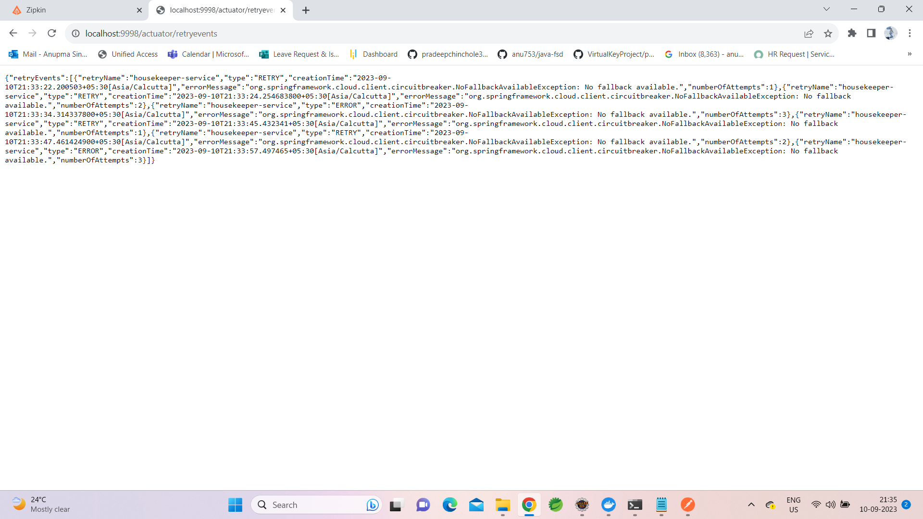

Slide 18
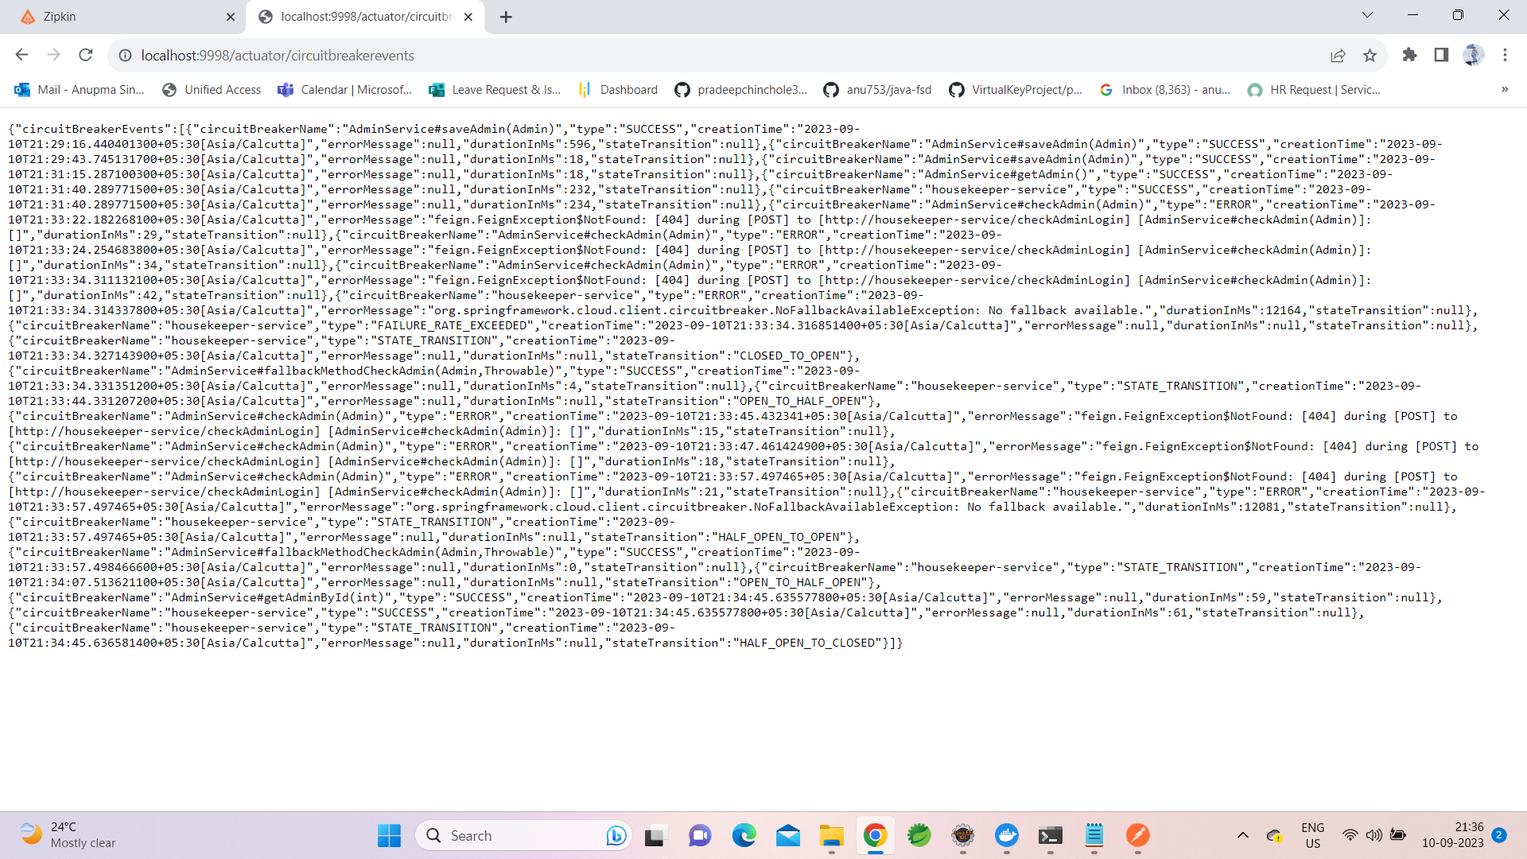

Slide 19
Sleuth and Zipkins:
Zipkin is a distributed tracing system. It helps gather timing data needed to troubleshoot latency problems in service architectures. Features include both the collection and lookup of this data.
Sleuth is another tool from the Spring cloud family. It is used to generate the trace id, span id and add this information to the service calls in the headers and MDC, so that It can be used by tools like Zipkin and ELK etc. to store, index and process log files.

Slide 20
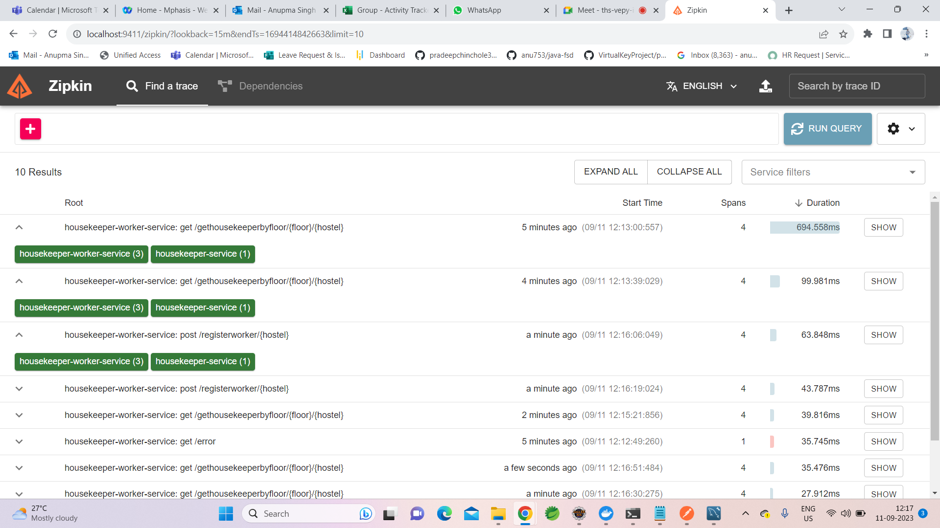

Slide 21
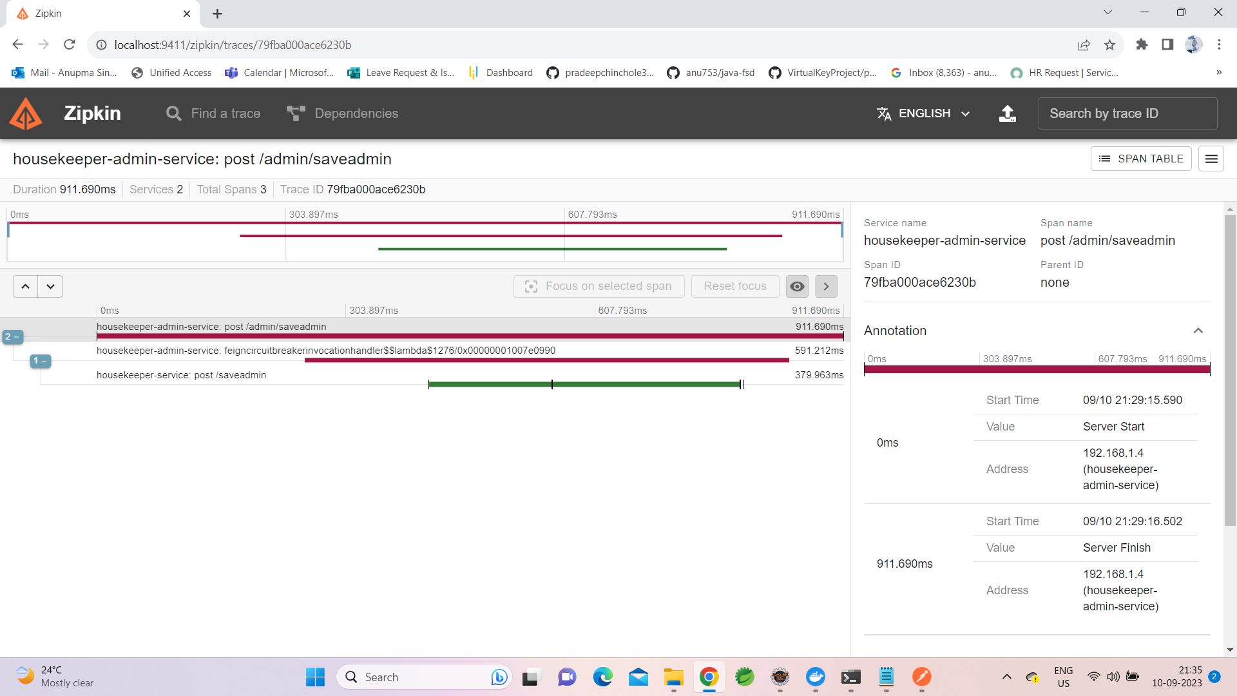

Slide 22
Admin Module:
Admin login module : Managing administrative operations related to an entity called "Admin." It handles creating, retrieving, and checking admin entities using appropriate HTTP endpoints.
Save Admin: It is used to save admin details with admin_id , username , Password and hostel details.
Get All Admins: It retrieves a list of all admin.
Check Admin Login: It takes an Admin object in the request body, checks if the provided admin credentials are valid or not
Get Admin by ID: It takes an admin ID , fetches the corresponding admin

Slide 23
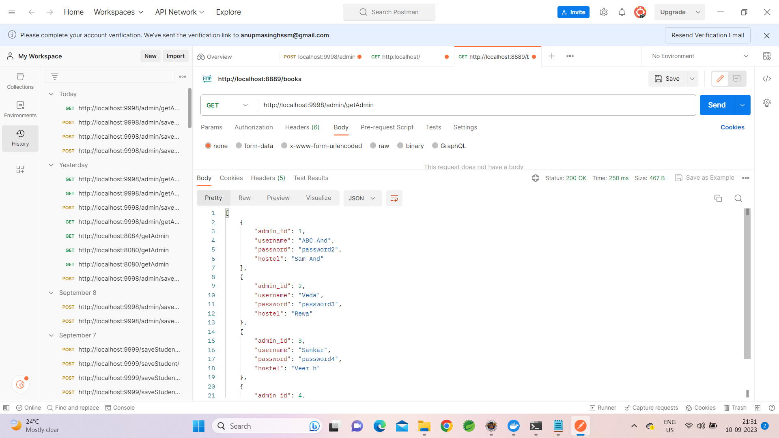

Slide 24
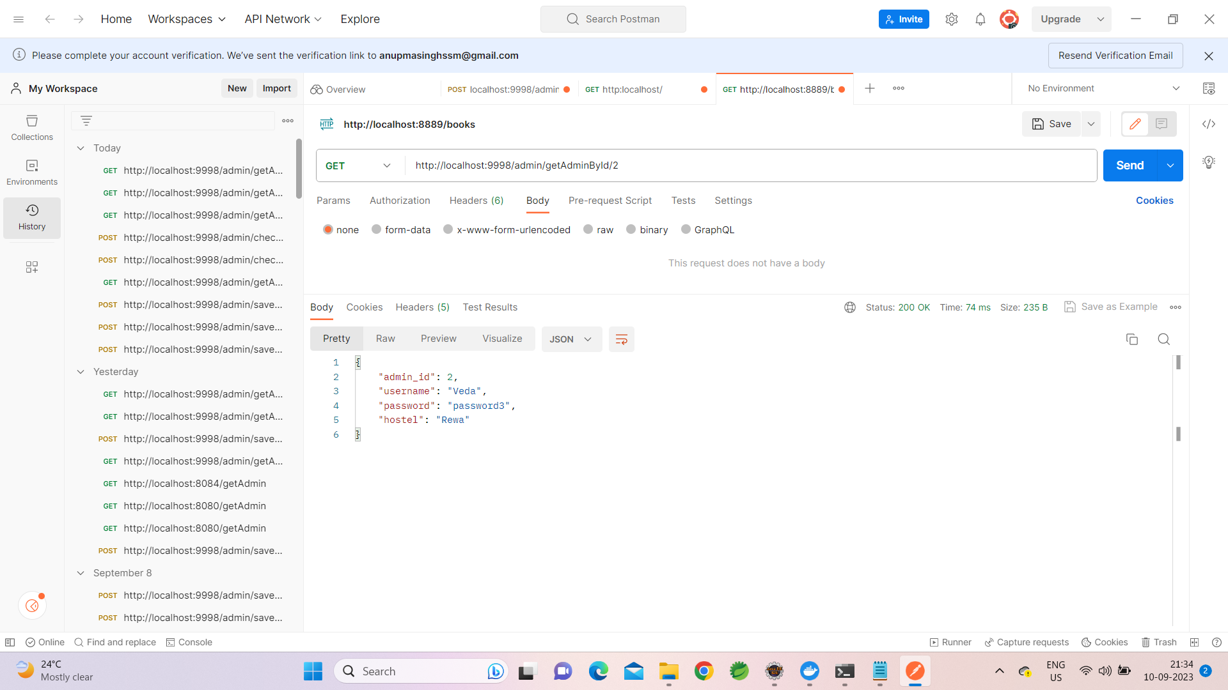

Slide 25
Student Module:
Student module: Managing administrative operations related to an entity called “Student." It handles creating, retrieving, and checking student entities using appropriate HTTP endpoints.
Save Student: It is used to save student details with rollnumber, name, password, floor, and hostel details.
Get All Student: It retrieves a list of all students.
Check Student Login: It takes a Student object in the request body, checks if the provided student credentials are valid or not
Get Student by ID: It takes a student rollnumber , and fetches the corresponding student.
Change Password of the Student: It is used to change the password of a student.
Update Student profile: it is used to update the student profile.

Slide 26
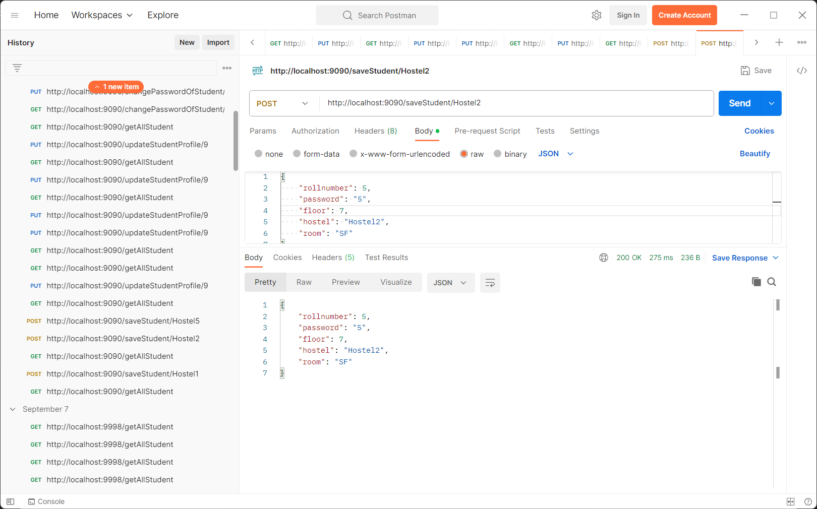

Slide 27
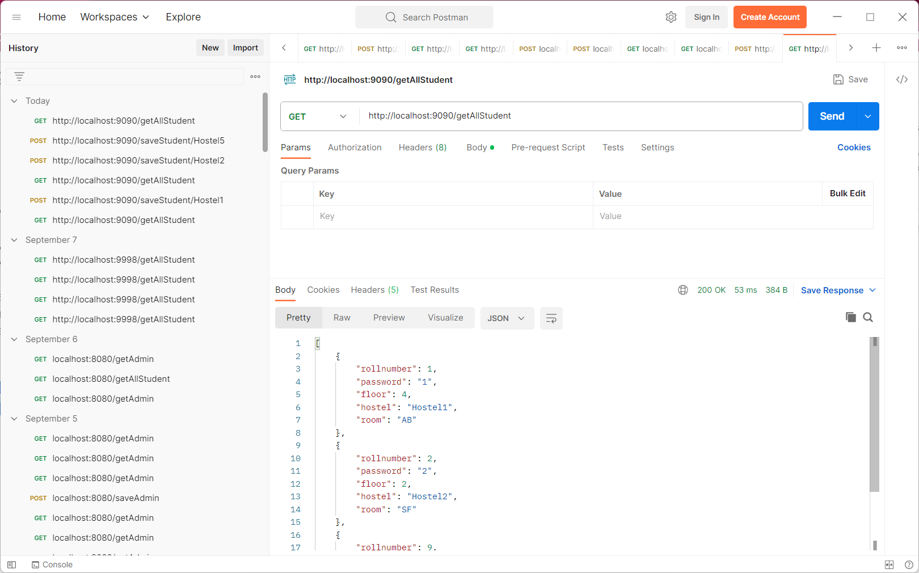

Slide 28
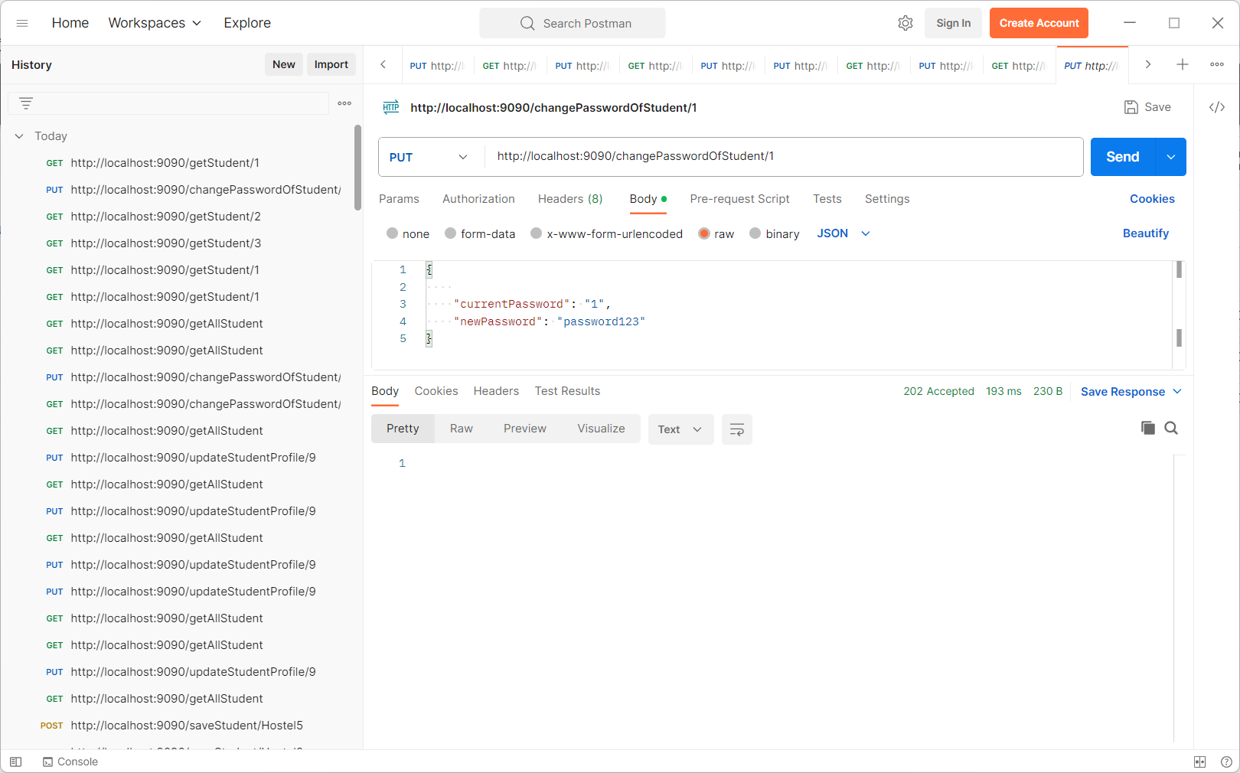

Slide 29
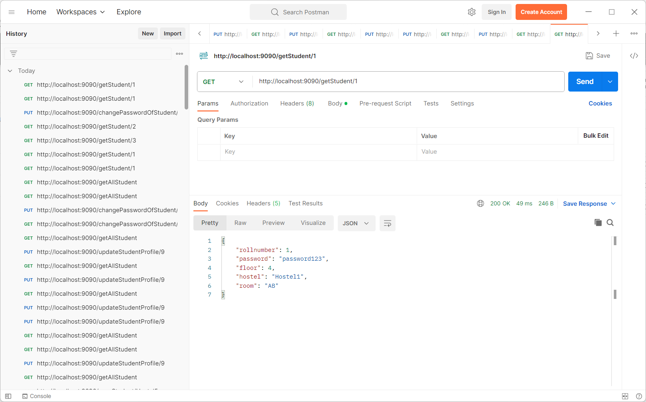

Slide 30
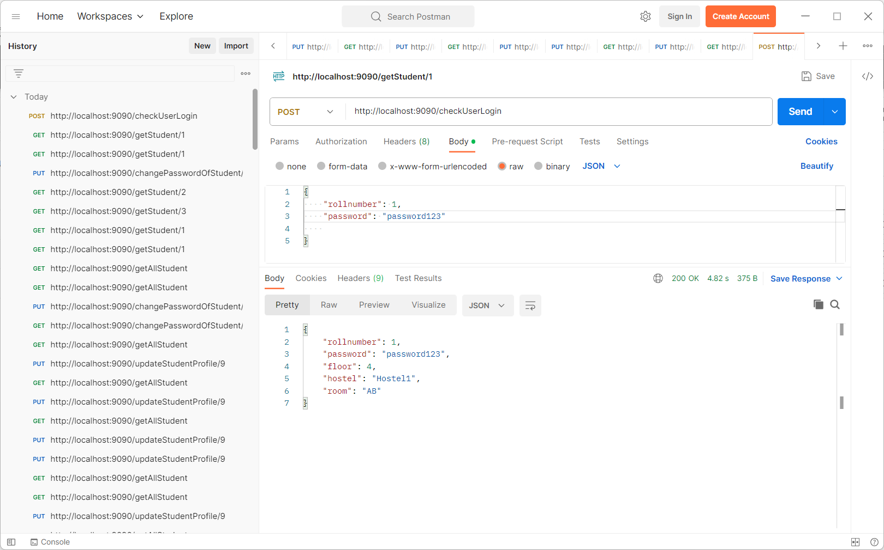

Slide 31
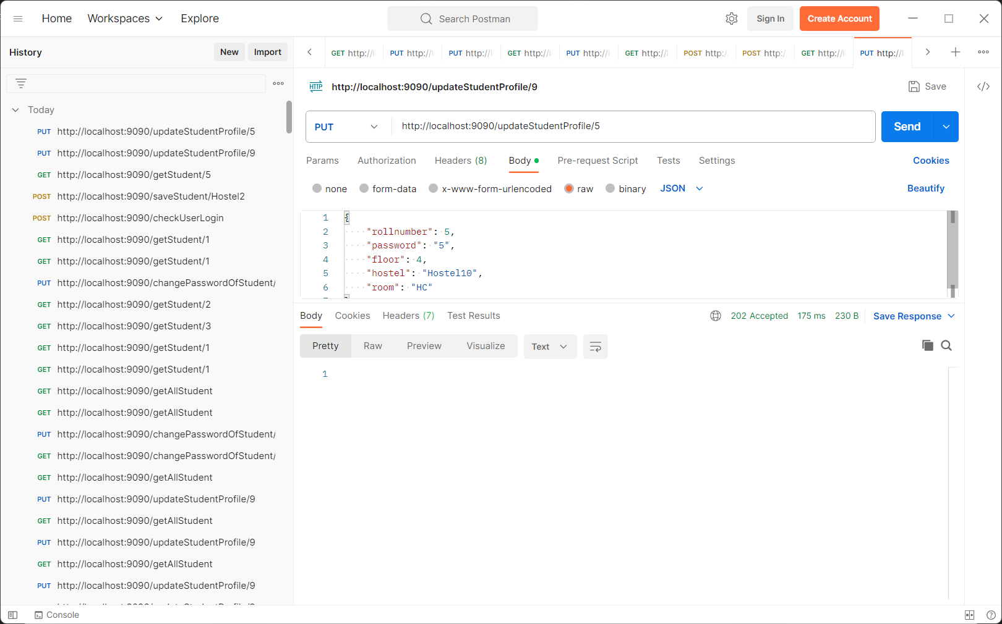

Slide 32
Worker Module:
Register housekeeper: It is used to save the housekeeper details.
Get housekeeper by floor: It is used to get the housekeeper by floor no and hostel.
Get housekeeper by ID : It is used to find housekeeper by ID

Slide 33
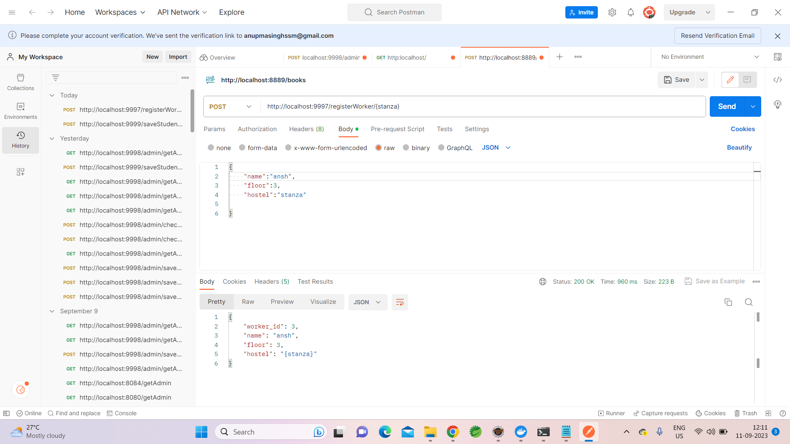

Slide 34
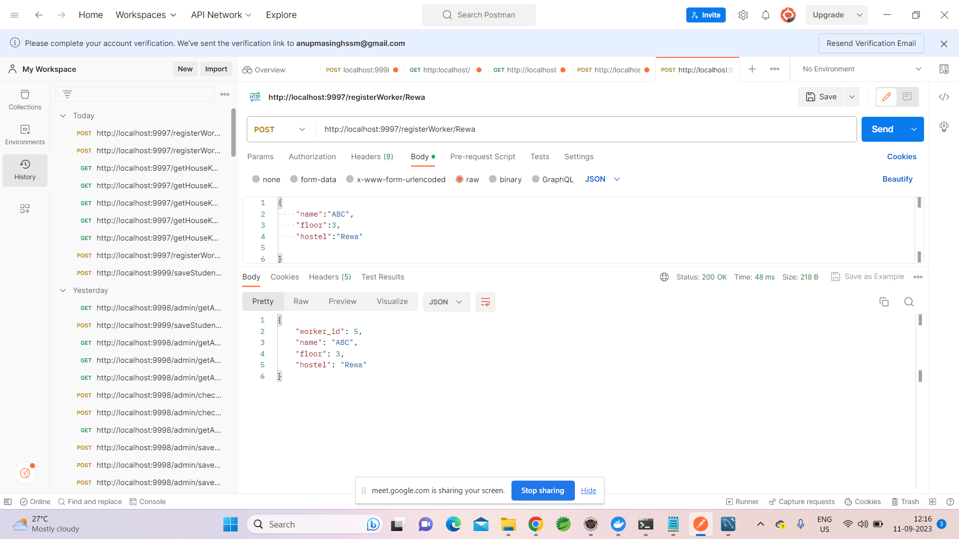

Slide 35
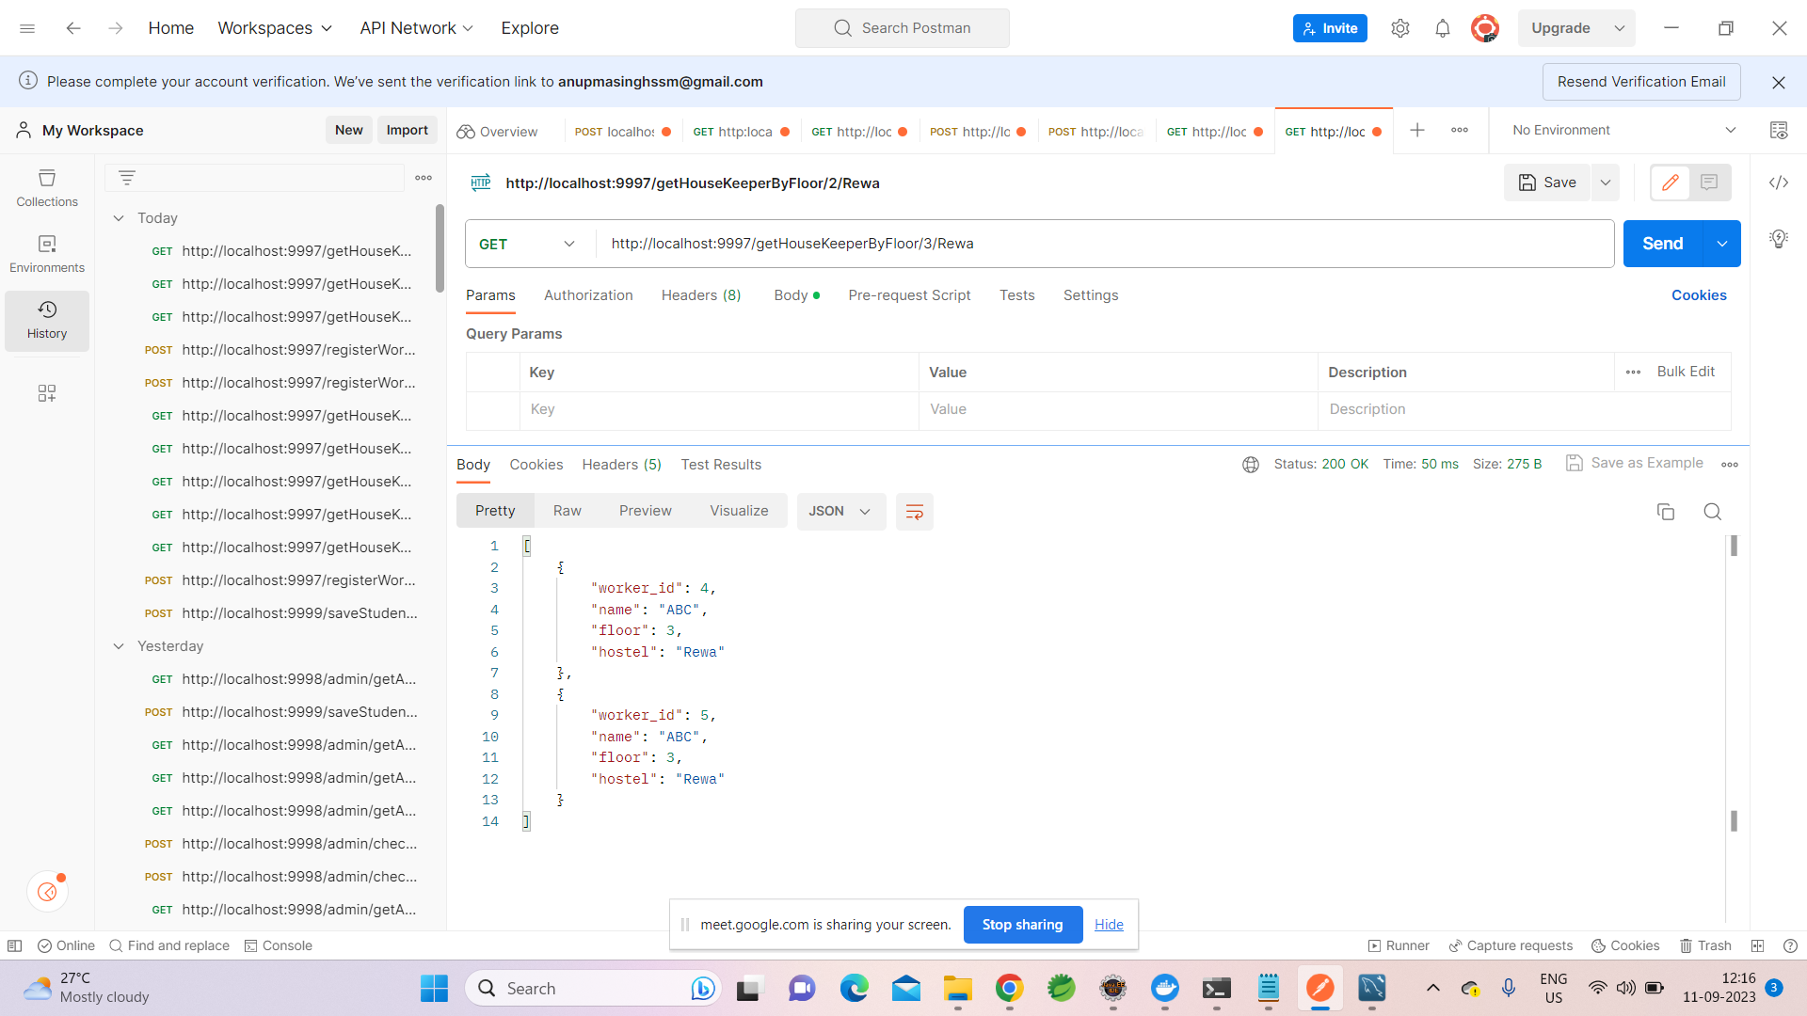

Slide 36
Clean Request Module:
Submit Cleaning Request.
When a POST request is made, it links the request with a specific student using their roll number.
Get Request Count
Retrieves the number of cleaning requests made by a student based on their roll number.
Get Cleaning Requests by Student
Retrieves a list of all cleaning requests associated with a student based on their roll number

Slide 37
Contd..
Get All Cleaning Requests by Hostel
Retrieves a list of all cleaning requests made for a particular hostel.
Get Cleaning Request Count by Hostel
Retrieves the number of cleaning requests made for a specific hostel.
Get Cleaning Request by ID
Retrieves a cleaning request based on its unique identifier (ID).
Allot Housekeeper to Cleaning Request
Links a housekeeper (worker) to a cleaning request, marking it as completed

Slide 38
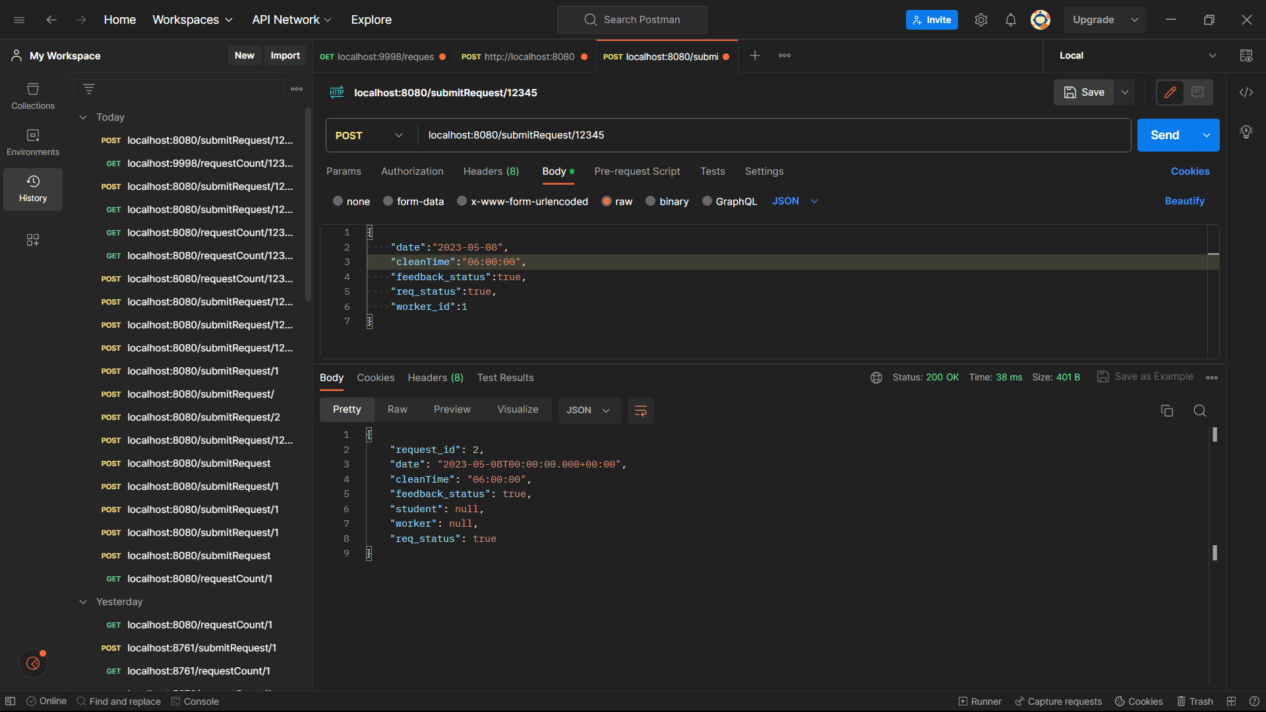

Slide 39
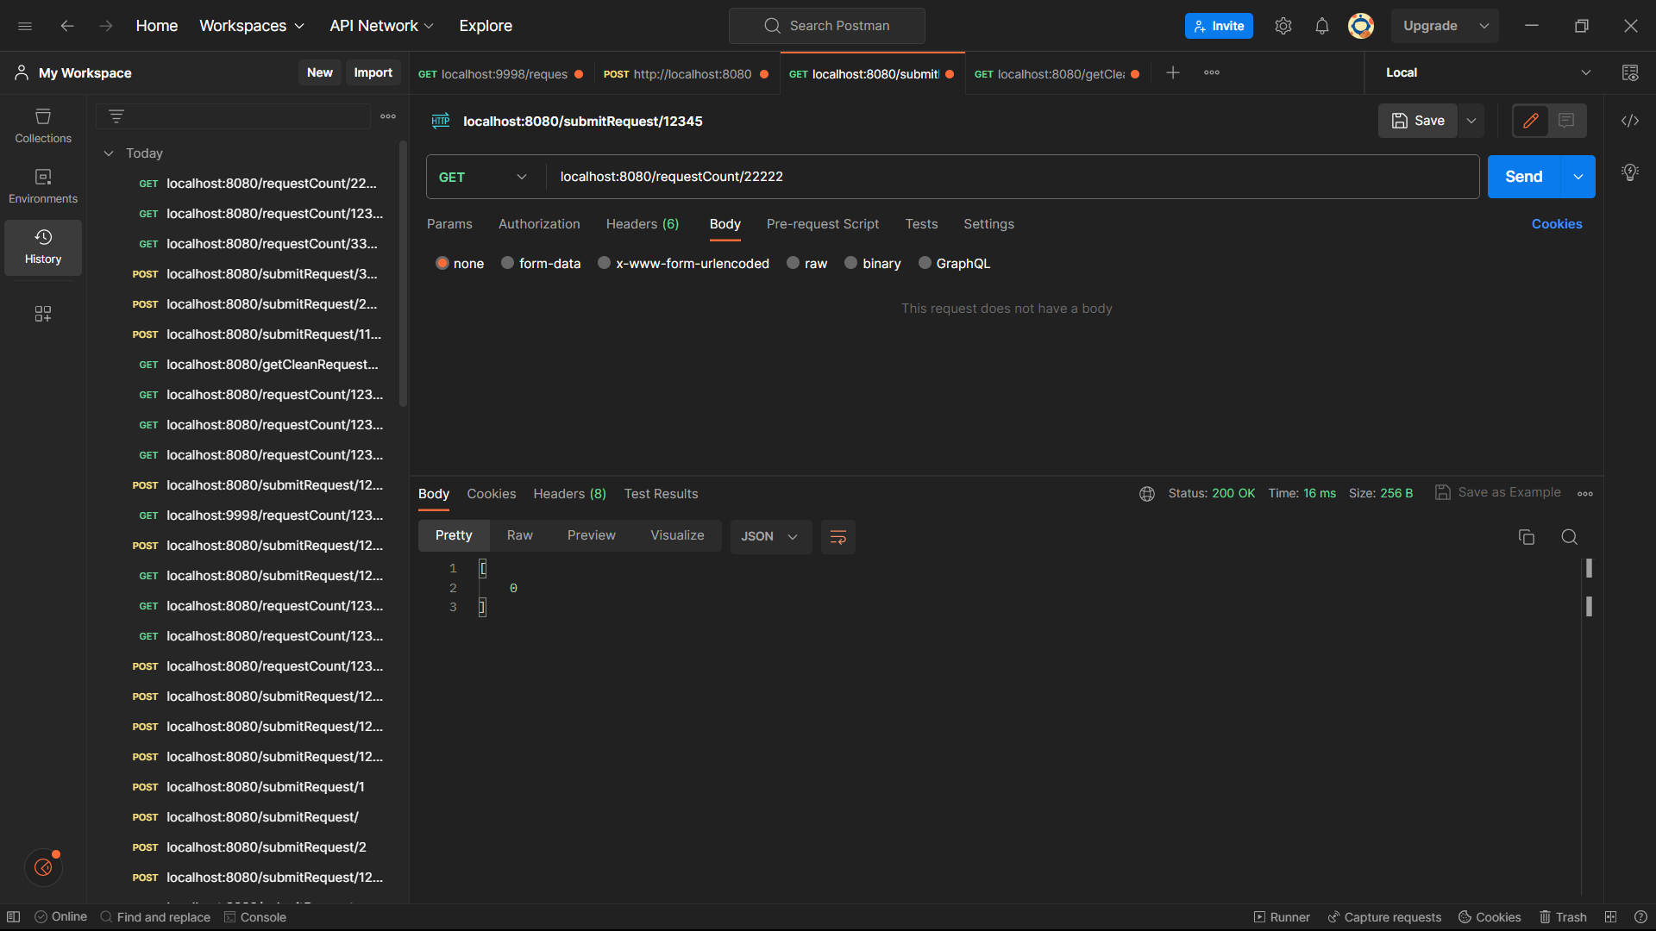

Slide 40
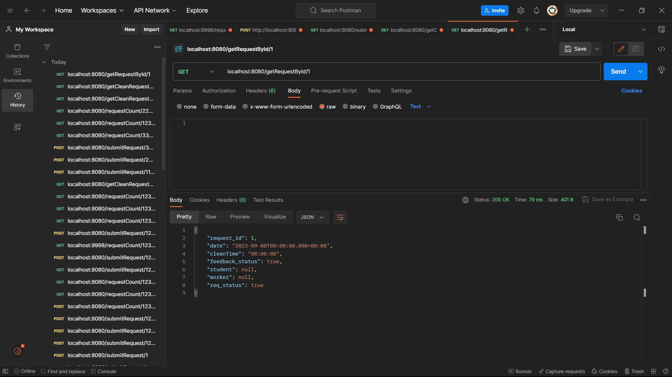

Slide 41
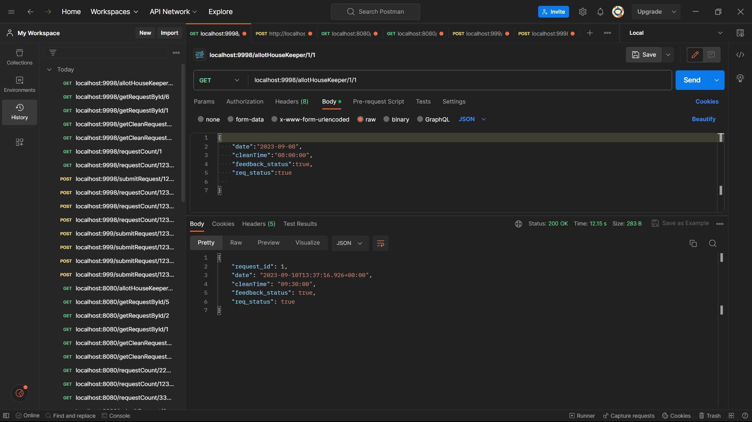

Slide 42
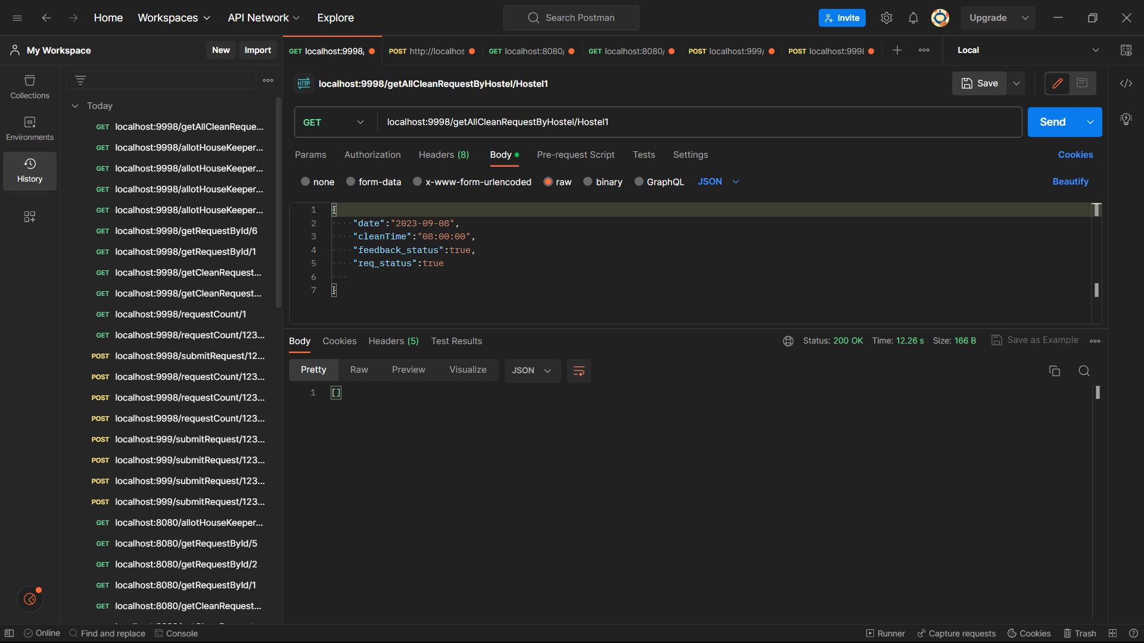

Slide 43
Feedback Module:
Submit feedback:
This functionality allows a user (presumably a student) to submit feedback for a specific clean request.
Get Feedback Count for a Hostel:
This functionality retrieves the count of feedback submissions for a specific hostel.
Get Feedback Count by Student Roll Number:
This functionality retrieves the count of feedback submissions for a specific student using their roll number.
Get All Feedback for a Hostel:
This functionality retrieves all feedback submissions for a specific hostel.

Slide 44
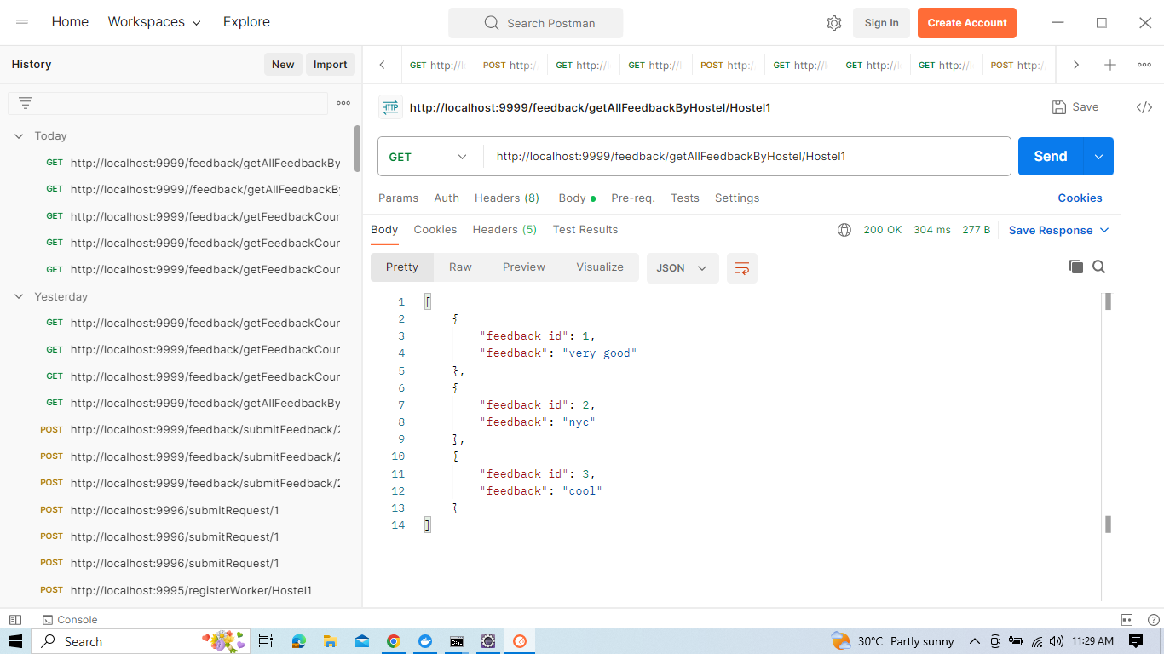

Slide 45
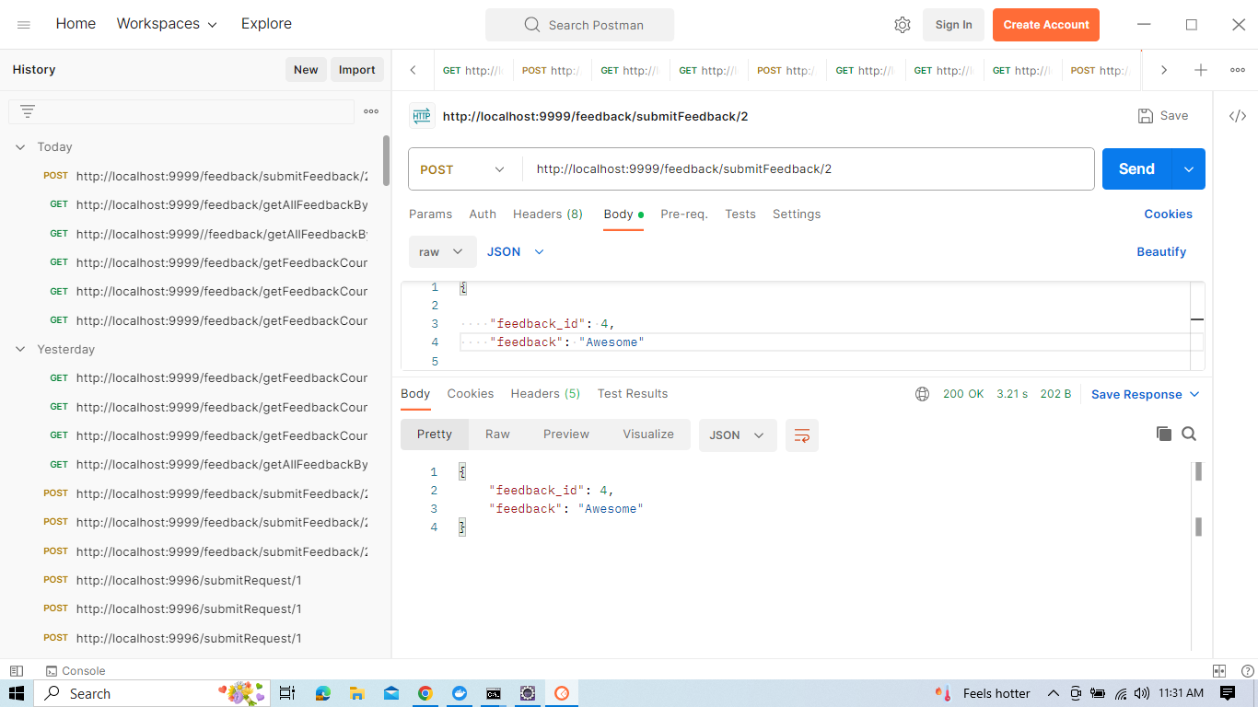

Slide 46
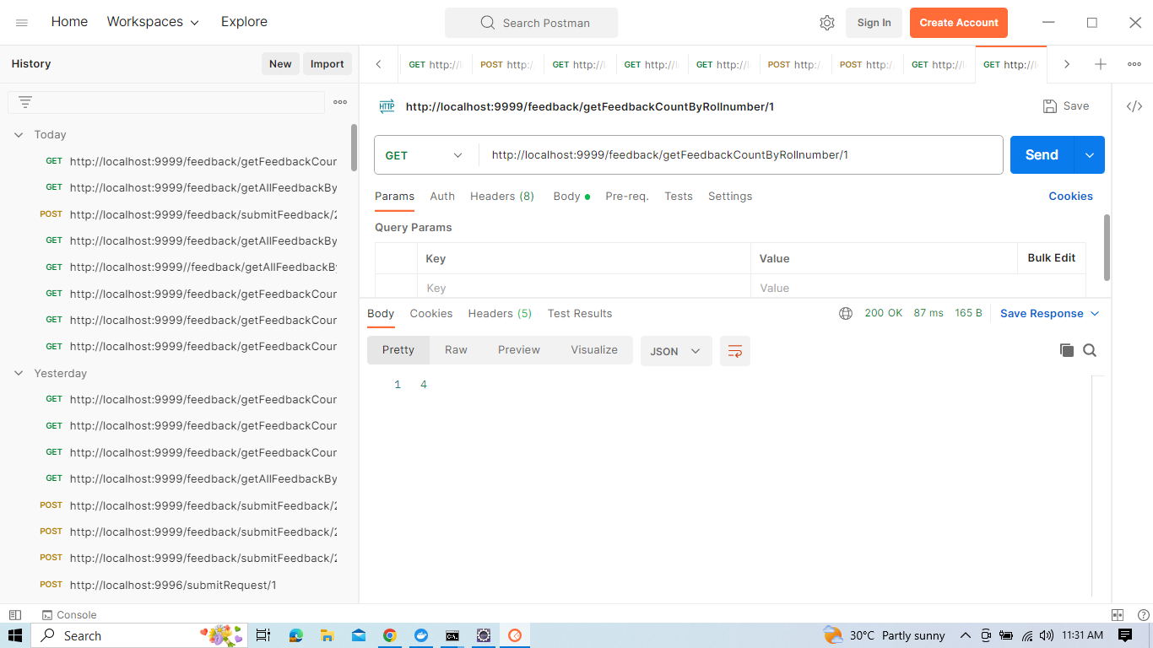

Slide 47
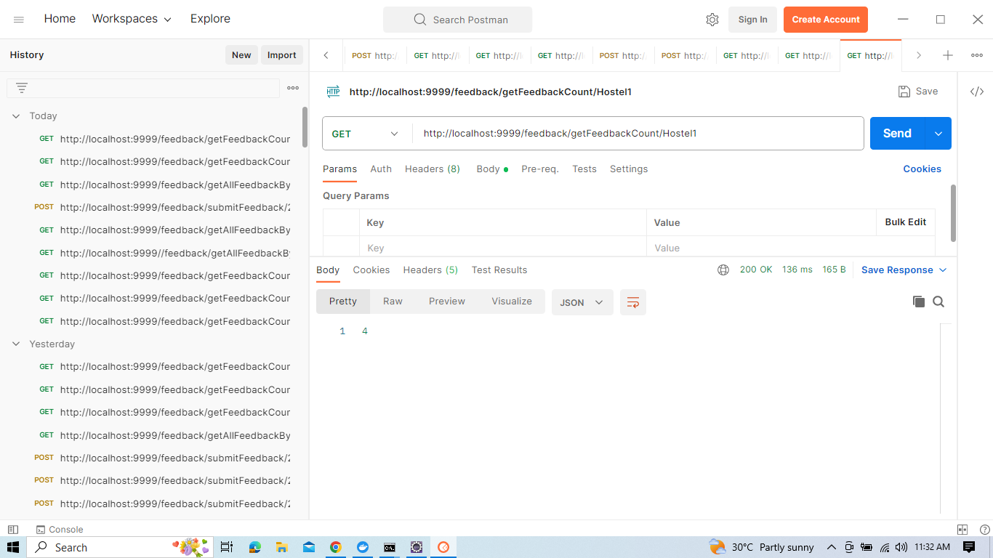

Slide 48
Advantages:
This system is very easy to understand and user friendly.
Student and Housekeeper are connected with each other on one system.
This system is saving the time for student and hostel warden too.
In this system user can connect any time whenever he/she wants.

Slide 49
Conclusion:
This is a simple user-friendly application developed for hostel students.
This makes work very simple for both students and admin.
The student can send clean request when he wishes and the admin can allot housekeeper accordingly.
We have developed it simple as it is for students and admin for a particular hostel .

Slide 50


